Slide 2
The dictionary defines wisdom as:
“the quality of having experience, knowledge,
and good judgement; the quality of being wise.”
Notes:
You may never have thought of it before, but the Autumn and the Winter are especially difficult months to navigate. We often get sick quickly, take more time off school, and sometimes we can even feel emotionally low, which seems to mirror the state of the weather.
It’s for this reason that we’re talking about learning to be more wise, in the winter.
The dictionary defines wisdom as: “the quality of having experience, knowledge, and good judgement; the quality of being wise.”

Slide 3
For example
1. I’m experiencing the feeling of getting poorly.
2. I know It’s going to end up with me ill
3. I have good judgement enough
to take some medicine, drink more water,
and go to bed early
Notes:
Using the keywords from the definition, we could say, for example, that:
1. I’m experiencing the feeling of getting poorly.
2. I know It’s going to end up with me ill.
3. I have good judgement enough to take some medicine, drink more water, and go to bed early

Slide 4
Notes:
You might have come across some says which talk about wisdom and knowledge. You see, knowing something, isn’t the same as understanding what to do about it. You often have to have some wisdom to fully understand what’s going on around you.
Take, for example, these images.

Slide 5
Knowledge is knowing what to say.
Notes:
For example. (Go through each of the next 8 slides. The text is on the screen)

Slide 6
Knowledge is knowing what to say. Wisdom is knowing when to say it.

Slide 7
Knowledge is knowing a tomato is a fruit.

Slide 8
Knowledge is knowing a tomato is a fruit. Wisdom is knowing not to put it in a fruit salad

Slide 9
Knowledge is knowing the street is one way.

Slide 10
Knowledge is knowing the street is one way. Wisdom is looking both directions anyway.

Slide 11
Knowledge is knowing you’re stronger than your little sister.

Slide 12
Knowledge is knowing you’re stronger than your little sister. Wisdom is understanding a punch in the face from a six-year-old still really hurts!

Slide 13
Notes:
Wisdom is only helpful if it changes you. Someone might say something useful and ‘wise’ to you, but wisdom can be random.
Of course, sometimes someone will say something to you, which hits the nail on the head.
Here’s a great example of a celebrity you’ll know as Starlord, Chris Pratt, with some great wisdom, that’s not necessarily all relevant or particularly helpful.

Slide 14
engage schools

Slide 15
Notes:
If we’re honest, even when someone inspires us with wisdom, we often fail to do anything with it. The problem is that unless something becomes a habit, we forget about it quickly.
When you leave the assembly today, you’re going to be given a little practical gift. It’s a card you can keep, to remind you about some important things which you can try which will help you get through the winter.
It breaks down into these five things: sleep, eat, trust, pray, win.

Slide 16
Sleep
1. I experience tiredness.
2. I know that I need sleep.
3. I have good judgment enough to go to bed early.

Slide 17
Eat
1. I’m experiencing sluggishness.
2. I know it’s because I enjoyed the holiday.
3. I have good judgment enough to eat healthy food and energise my body.

Slide 18
Trust
1. I’m experiencing loneliness.
2. I know some people care about me.
3. I have good judgment enough
to talk to someone I can trust.

Slide 19
Pray
1. I’m experiencing problems in my
thoughts and feelings.
2. I know it’s because I'm struggling to speak up.
3. I have good judgment enough to stop and reflect.

Slide 20
Win
1. I’m experiencing chaos.
2. I know it’s because everything
feels out of control.
3. I have good judgment enough to find
something I can achieve today.
Notes:
As in, my room is untidy, or I can’t organise myself in the morning, or get to bed on time.

Slide 21
You could be told 1000 times to eat healthily, get more sleep, to speak up when you’re struggling, to take more time to reflect, or pray, or to win at something which will help you, every day.
But it’s only going to help if you respond to these thoughts & feelings for yourself.
Notes:
Listening to wisdom is a choice.
You could be told 1000 times to eat healthily, get more sleep, to speak up when you’re struggling, to take more time to reflect, or pray, or to win at something which will help you, every day.
But it’s only going to help if you respond to these thoughts & feelings for yourself.

Slide 22
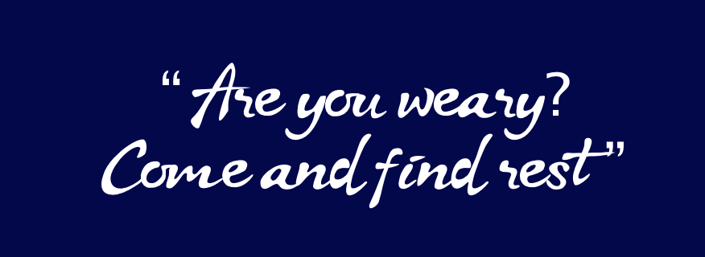
Notes:
Optional extra thought from the Bible
As we close, I'd like to draw your attention to an old piece of wisdom from the Bible. It's from the gospel of Matthew, and it's something Jesus is reported to have said.
The language is old, but in a nutshell, Jesus says something like this:
Are you struggling, overtired or in need of encouragement? Don't panic. Everything you need is available to you.
In the passage, Jesus makes it clear, that the feeling of peace, is available all who ask, who speak up and who admit they're not okay.
Thank you for listening, and I hope you find some peace of mind and heart today.

Slide 23
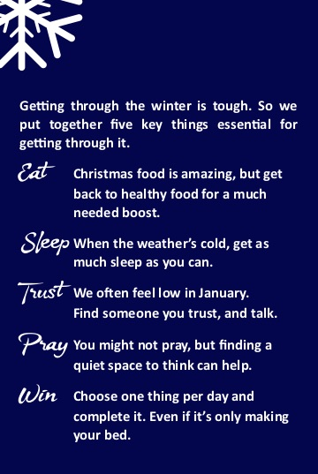
Notes:
These images are what the Winter Wisdom card looks like, which will be given to the students.

