Slide 1


Slide 2


Slide 3
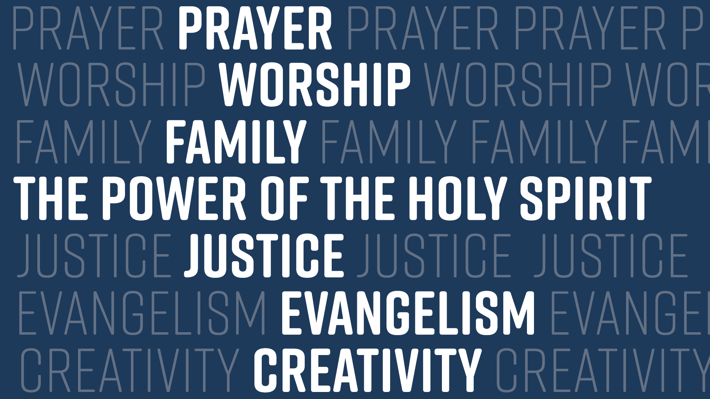

Slide 4


Slide 5


Slide 6


Slide 7


Slide 8
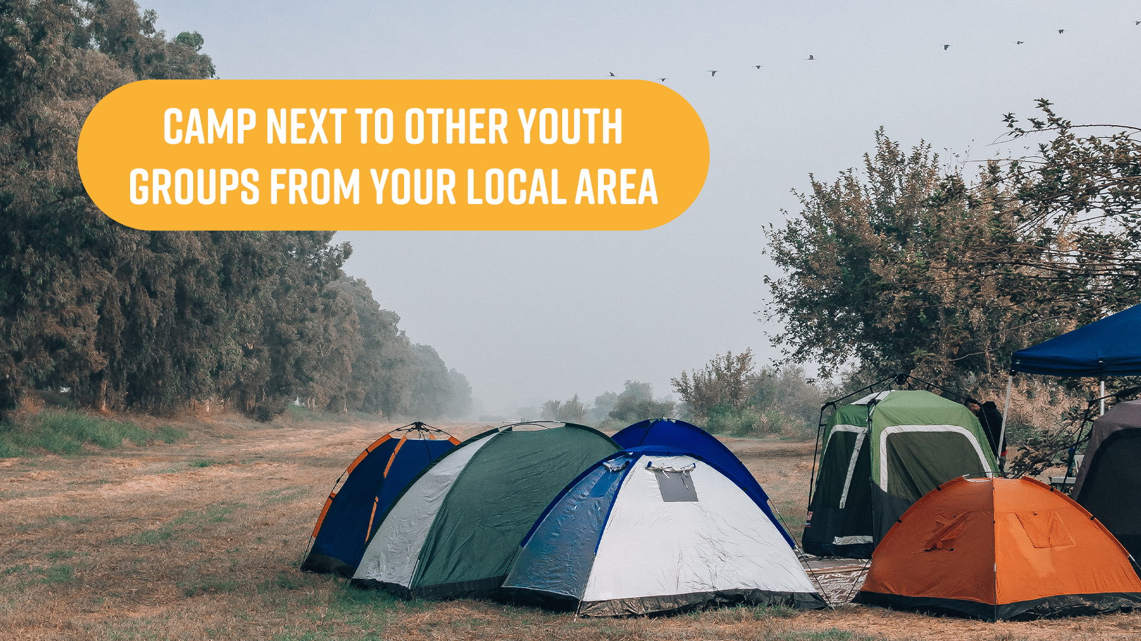

Slide 9


Slide 10


Slide 12
Rooted
and
resilient

Slide 13

Revelation 2:2-5
I know your deeds, your hard work and your perseverance. I know that you cannot tolerate wicked people, that you have tested those who claim to be apostles but are not and have found them false. You have persevered and have endured hardships for my name and have not grown weary.
Yet I hold this against you: You have forsaken the love you had at first. Consider how far you have fallen! Repent and do the things you did at first.

Slide 14
discuss
Where in your ministry or church is it easiest to prioritise good deeds and sound teaching over love?
Are there any idols or 'sacred cows' in your church or ministry?

Slide 15
Ephesians 3:14-19
For this reason I kneel before the Father, from whom every family in heaven and on earth derives its name. I pray that out of his glorious riches he may strengthen you with power through his Spirit in your inner being, so that Christ may dwell in your hearts through faith. And I pray that you, being rooted and established in love, may have power, together with all the Lord’s holy people, to grasp how wide and long and high and deep is the love of Christ, and to know this love that surpasses knowledge—that you may be filled to the measure of all the fullness of God.

Slide 16
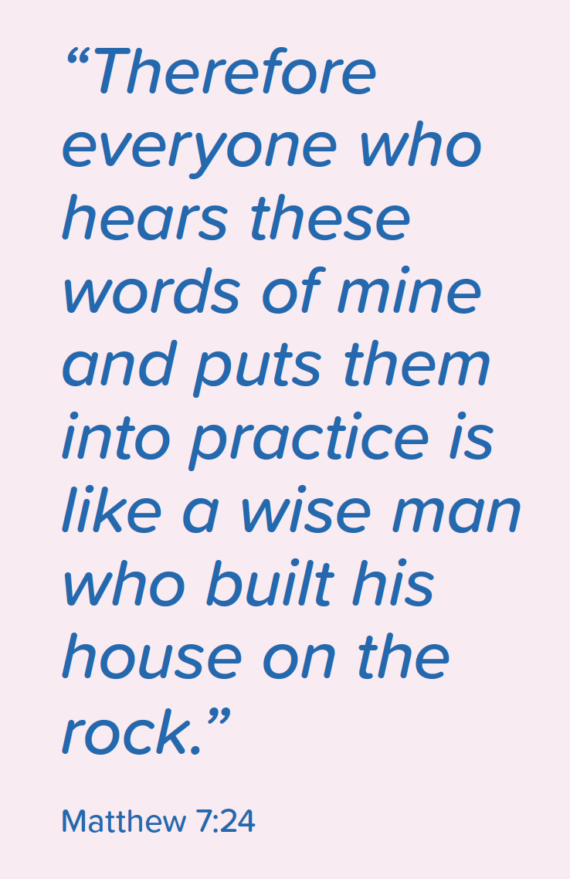
Context
Notes:
Jesus calls us to implement his teaching – not just rehearse it…

Slide 17

Reviewed existing research
Surveyed 235 youth workers
13 case studies
Get a copy at www.youthscape.co.uk/we-do-god
Notes:
Can buy a copy – or get a sample for free
I want to start where all research presentations start – and that’s with a gif

Slide 18
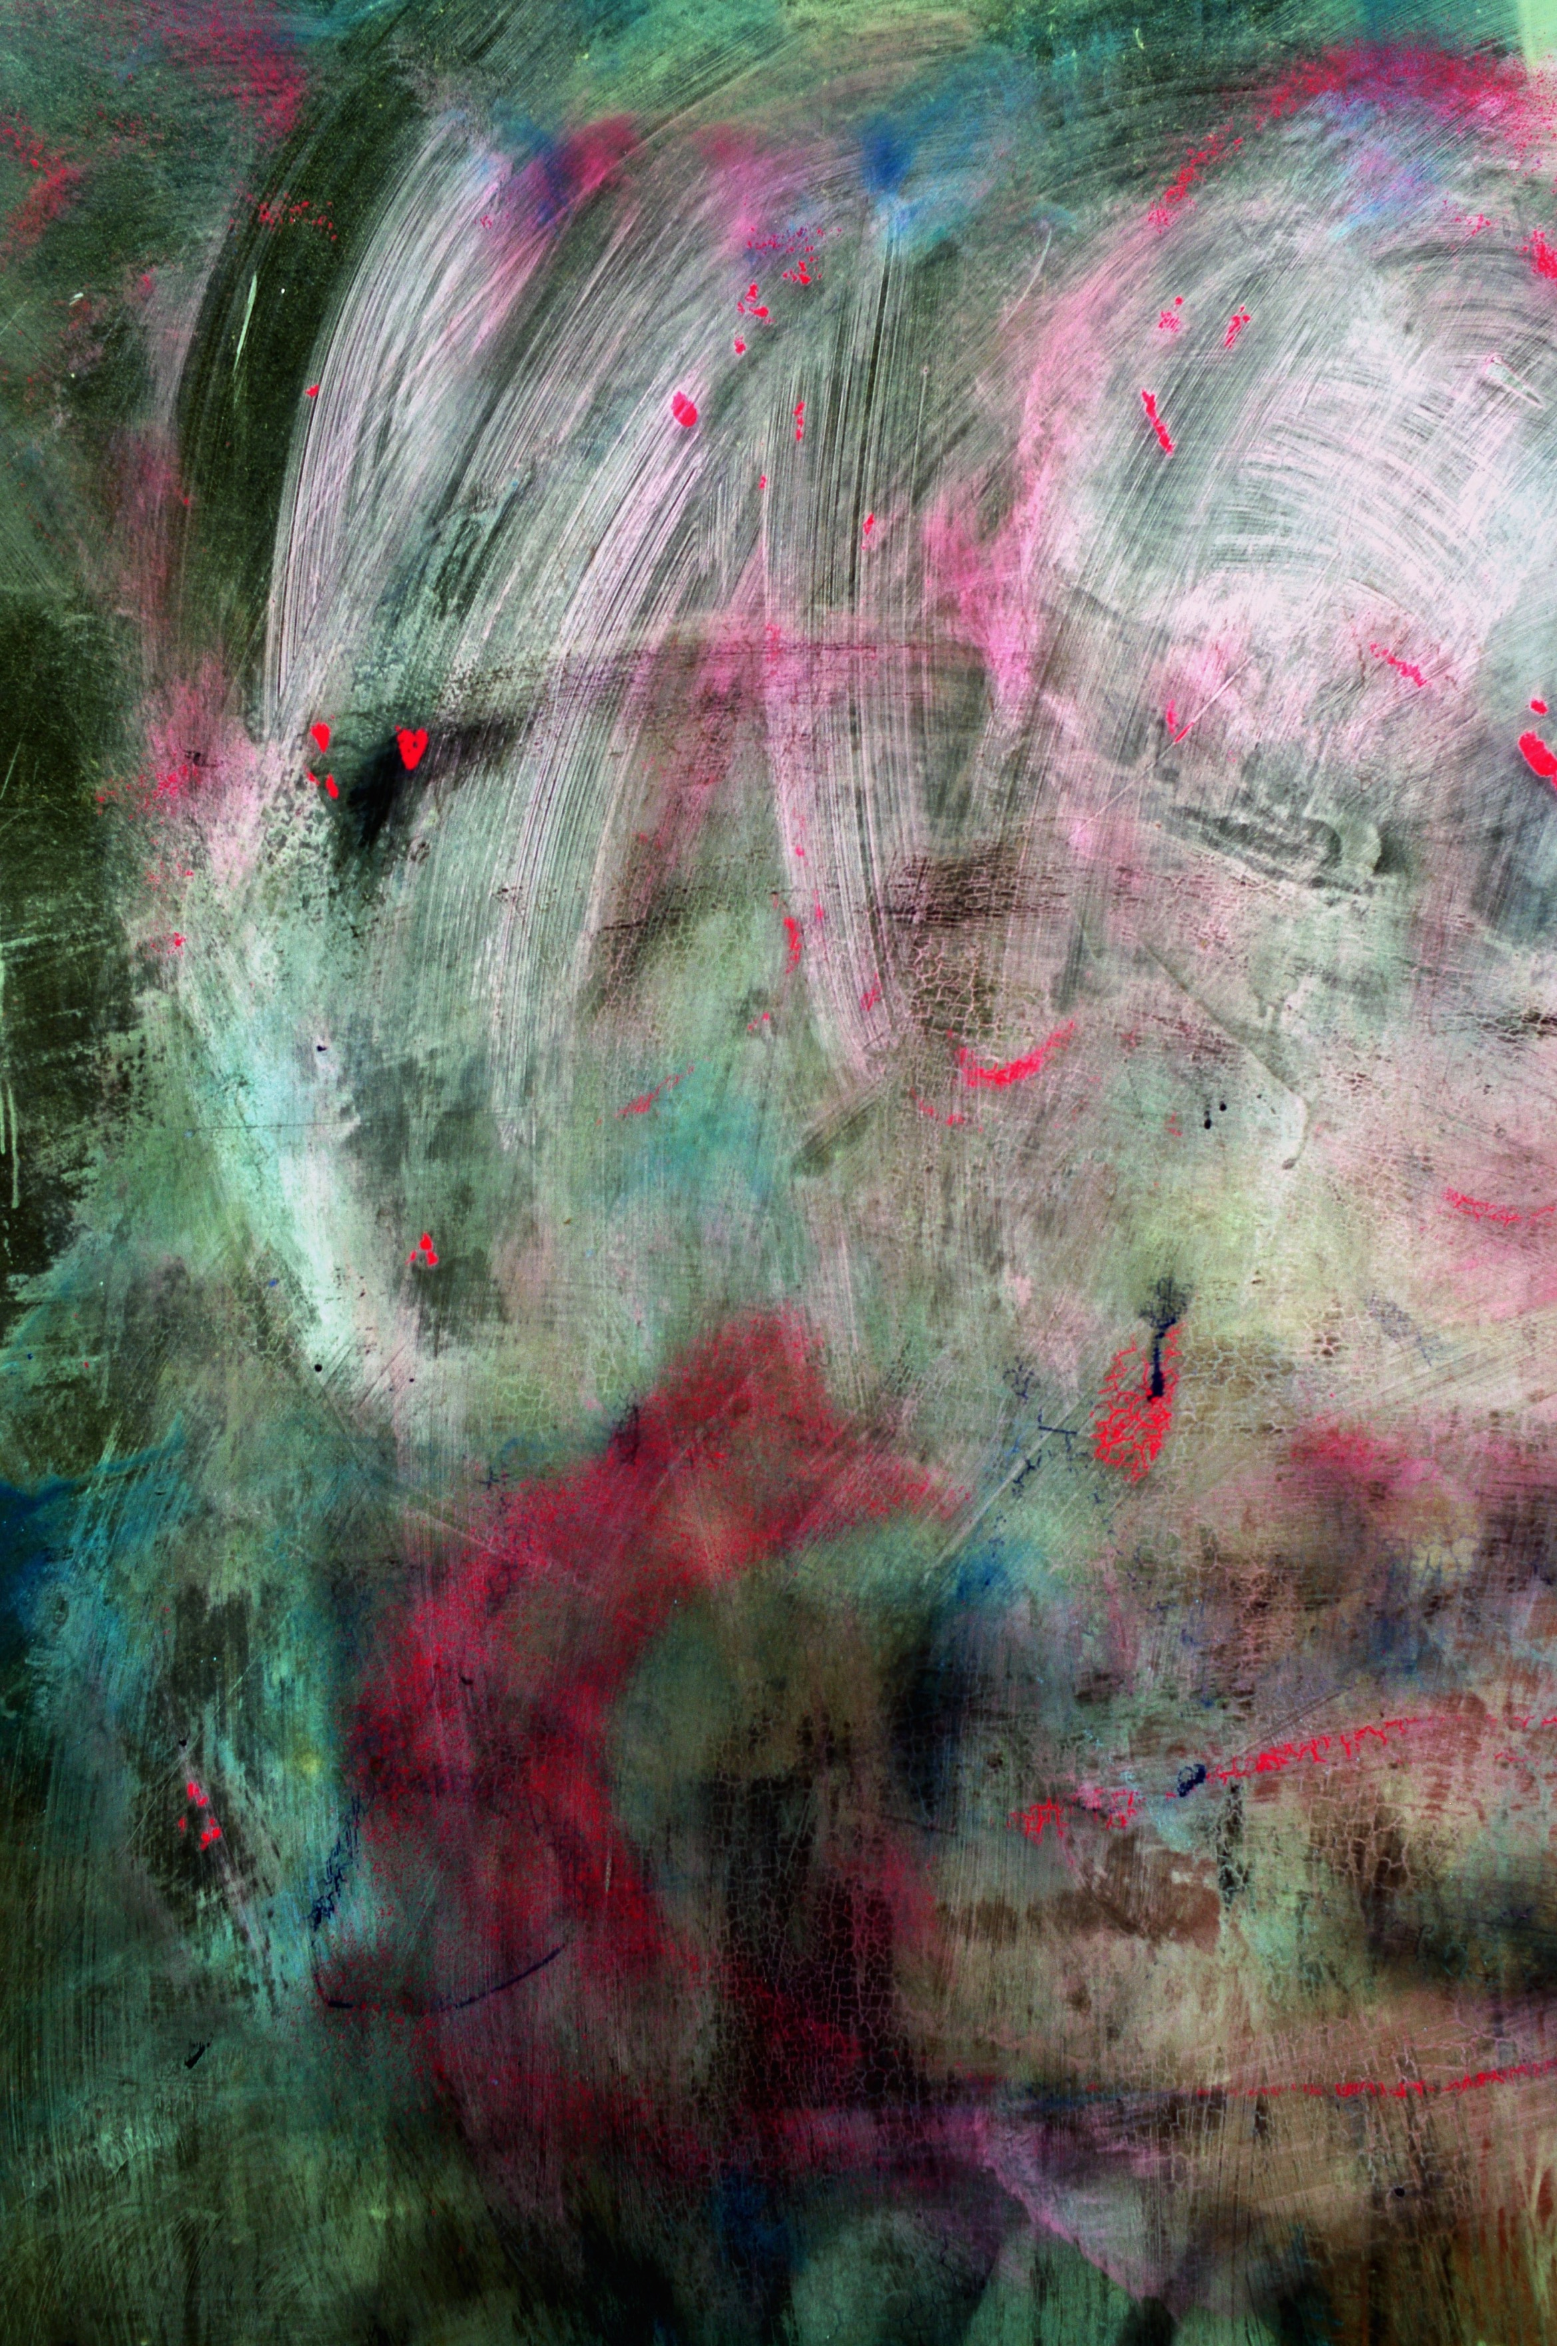
”Things Christian people do together over time
in response to, and in the light, of God’s active presence
for the life of the world.”
Healing
Baptism
Living simply
Communion
Lament
Resting
Fasting
Forgiveness
Loving your enemies
Attending church services
Prayer
Service
Reading scripture
Hospitality
Generosity
Testimony
Confession
Creativity
Celebration
Worship
Evangelism
Challenging injustice
Notes:
What do I mean by practices? 5/7 mins
This is a list of Christian practices drawn from looking at many lists of spiritual disciplines etc – it’s not comprehensive because everyone would probably write their list differently
This definition from Dorothy Bass and co – practice is “Things Christian people do together over time in response to, and in the light, of God’s active presence for the life of the world.”
Not just anything that Christians do,
What makes these Christian practices is that they’re what we do in community, have done over time – and in response to what God is doing in the contexts we are in.
They express our participation in God’s story and are ways we relate to God and take part in his mission too.
Important caveat - this is not always straightforward – Christianity has a chequered history, involving a whole lot of practice that has gone wayward, and has not been faithful to the call of Jesus. I’m sure as you look at this, you can recall times when people have abused these practices.
So we’re not saying we have done all these things well – but we are saying, together they capture so much of what it means to be Christian and to know God in our daily lives and in our communities.

Slide 19
Do you have a rule of life?

Slide 20
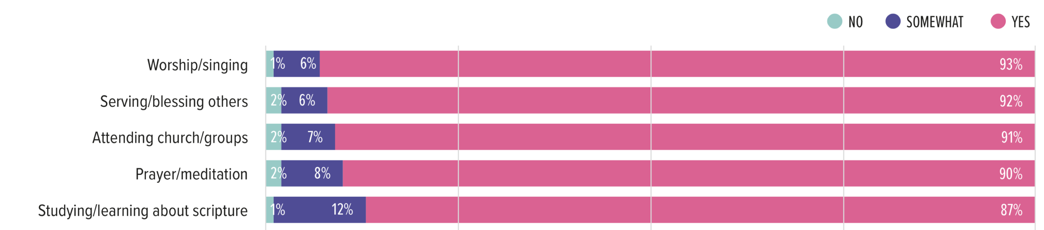
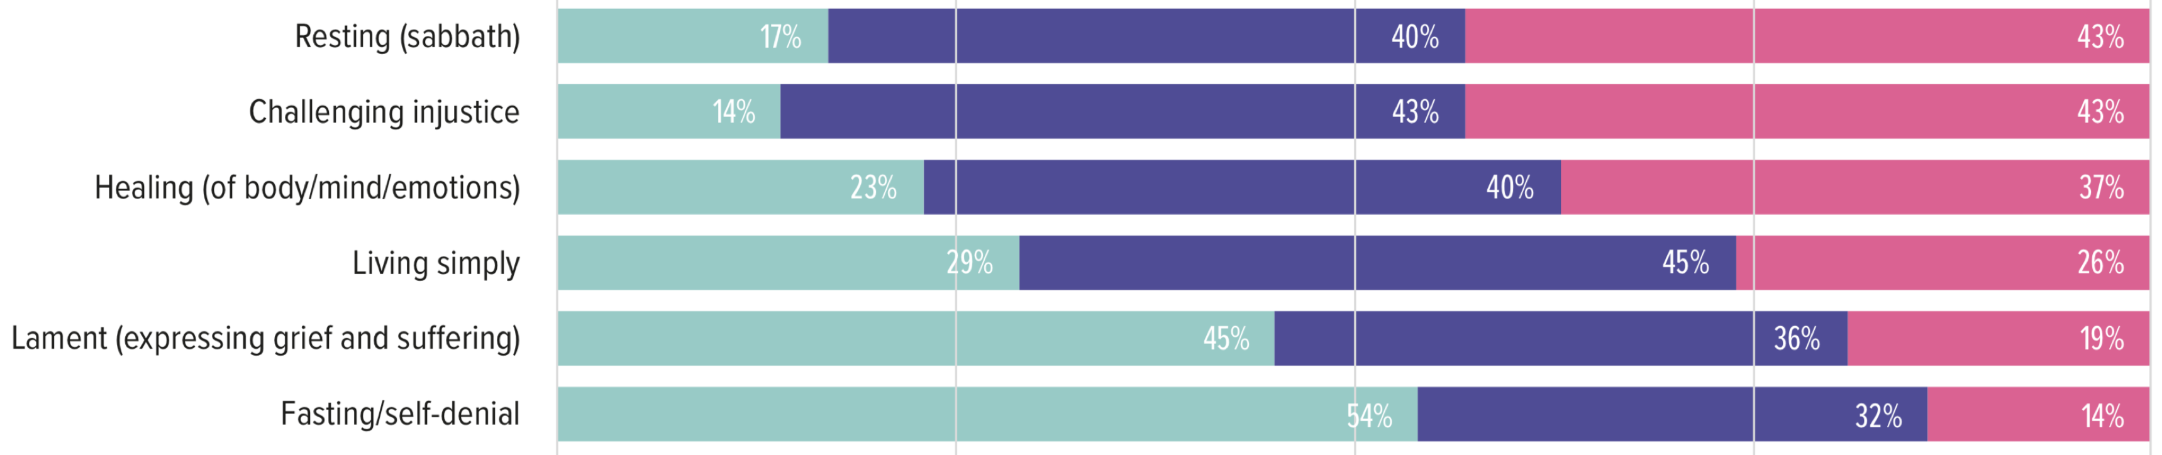
Which of these are you intentionally practicing?

Slide 21
Pre-pandemic
Taught about prayer - 83%, reading scripture - 83%
Taught about rest - 40%, lament – 34%
Invited to practice prayer – 83%, reading scripture – 79%
Invited to practice rest - 20%, lament – 26%

Slide 22
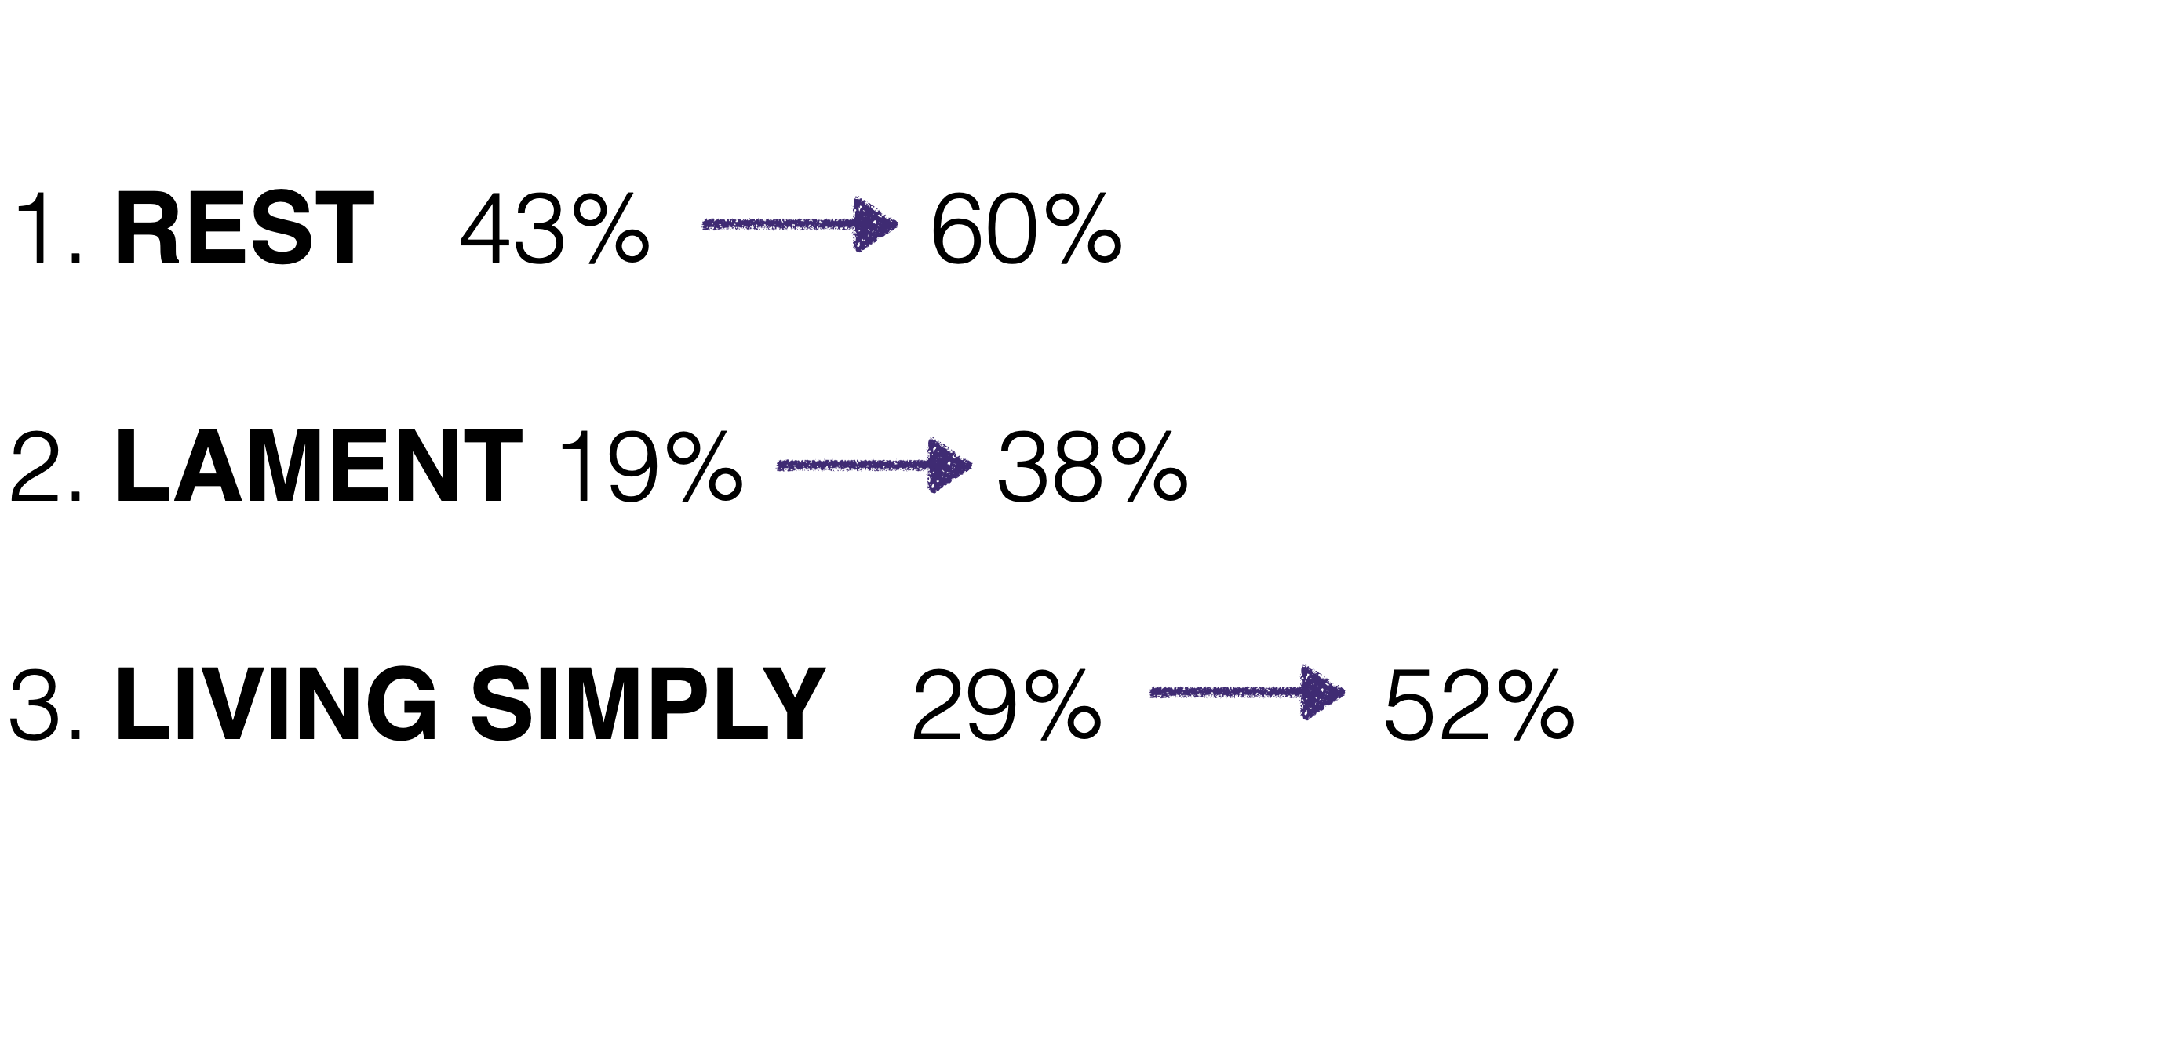
Post-pandemic

Slide 23
Reflect
In what ways do you currently practice faith?
Do you have a natural ‘rule of life’?’ What has not been shaken in these last few years?
Are you drawn to exploring any of these further?
Is God inviting you to broaden your spiritual practices to become more rooted, and more resilient?

Slide 24
Ephesians 3:14-19
For this reason I kneel before the Father, from whom every family in heaven and on earth derives its name. I pray that out of his glorious riches he may strengthen you with power through his Spirit in your inner being, so that Christ may dwell in your hearts through faith. And I pray that you, being rooted and established in love, may have power, together with all the Lord’s holy people, to grasp how wide and long and high and deep is the love of Christ, and to know this love that surpasses knowledge—that you may be filled to the measure of all the fullness of God.

